Slide 1
Adding long-term memory to digital fractors
Steven Dorsher
Professor Gary Bohannan
Chad Bohannan

Slide 2


Grunwald algorithm
Used for numerical computation of fractional derivatives and integrals
The history of the input signal is weighted according to its age-index (j) and the order of the differ-integral (α or q).

Slide 3
Grunwald weights- asymptotically power law

Slide 4


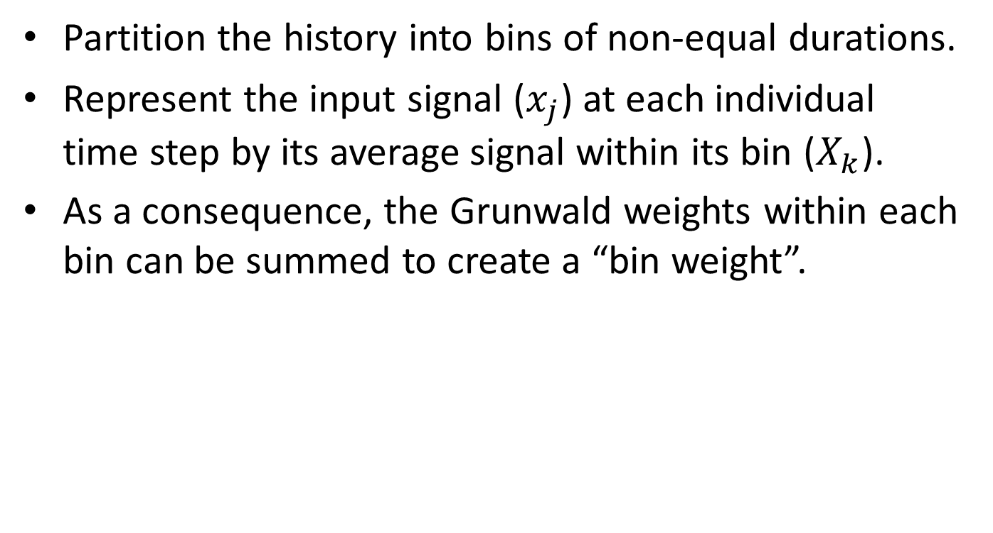
Binning algorithm
Partition the history into bins of non-equal durations.
Represent the input signal ($x_{j}$) at each individual time step by its average signal within its bin ($X_{k}$).
As a consequence, the Grunwald weights within each bin can be summed to create a “bin weight”.

Slide 5
Scaling of bin size
Bin sizes increase with age-index to include more low frequency content, while a smaller bin size at low age-index samples the high frequencies.

Slide 6
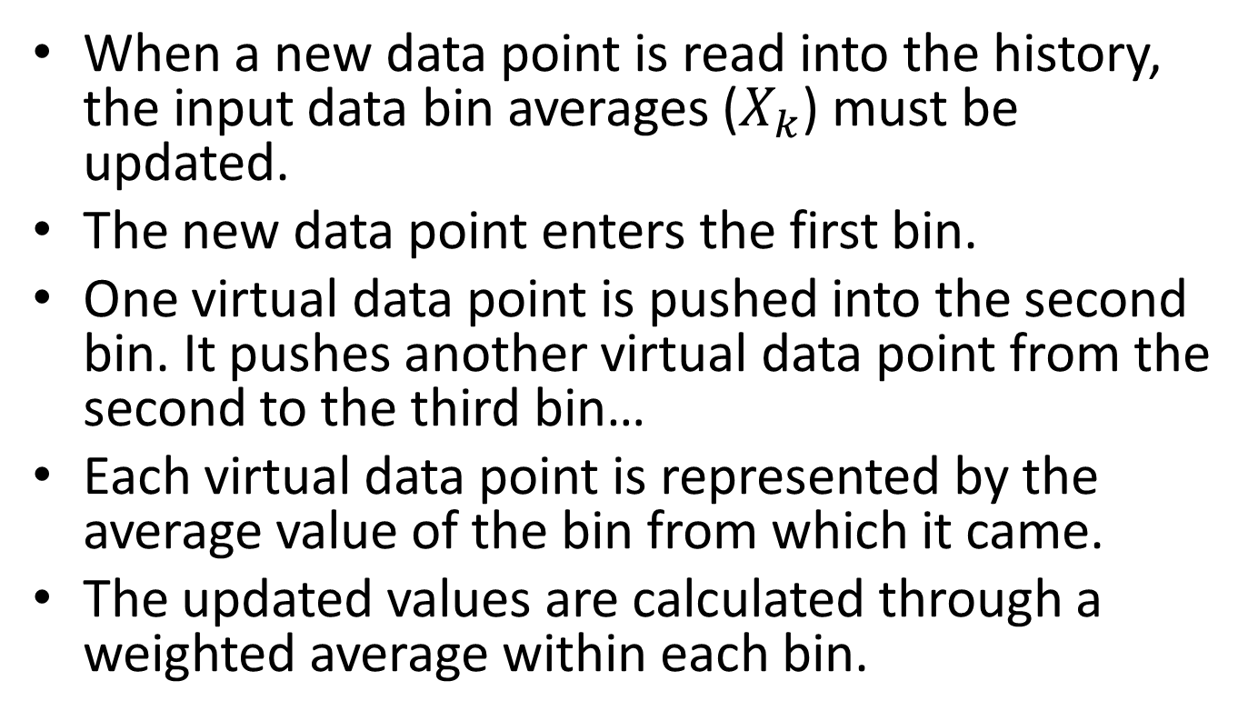
Updating the bin averages with a new time step
When a new data point is read into the history, the input data bin averages ($X_{k}$) must be updated.
The new data point enters the first bin.
One virtual data point is pushed into the second bin. It pushes another virtual data point from the second to the third bin…
Each virtual data point is represented by the average value of the bin from which it came.
The updated values are calculated through a weighted average within each bin.

Slide 7



Shifting virtual data
Scaling weights for partially
filled bins
Modified Grunwald
Updating bins
$c_{k}$= bin occupancy, $b_{k}$ = bin capacity

Slide 8
Methods of binning

Slide 9
Summed Grunwald weights
α=0.5, 0th index is 1, semi-log
α=-0.5, log-log

Slide 10
Confirmed phase reconstruction in time domain
f=0.7924 Hz

Slide 11
Phase reconstruction
Phase | CFE40 | GL | TERM26 | REC26 | GL26 | LIN26 | SQ26 | EXP26 | FIB2641
Fit | 44.965 | 44.238 | 49.763 | 28.060 | 23.031 | 46.101 | 44.428 | 42.104 | 42.984
Single | 45+-2 | 41+-2 | 41+-2 | 36+-2 | 32+-2 | 41+-2 | 41+-2 | 41+-2 | 41+-2
Phases from sinusoidal fits to the time series and from a single crossing
in the time domain.
Transients may impact phase reconstruction in some cases when the phase
has drifted a long way from its expected value anyway.

Slide 12
Improved low frequency response with similar memory usage
α=0.5

Slide 13
Improvement of 1.5 decades in frequency with 26 registers of history
α=0.3
α=-0.5

